Slide 1
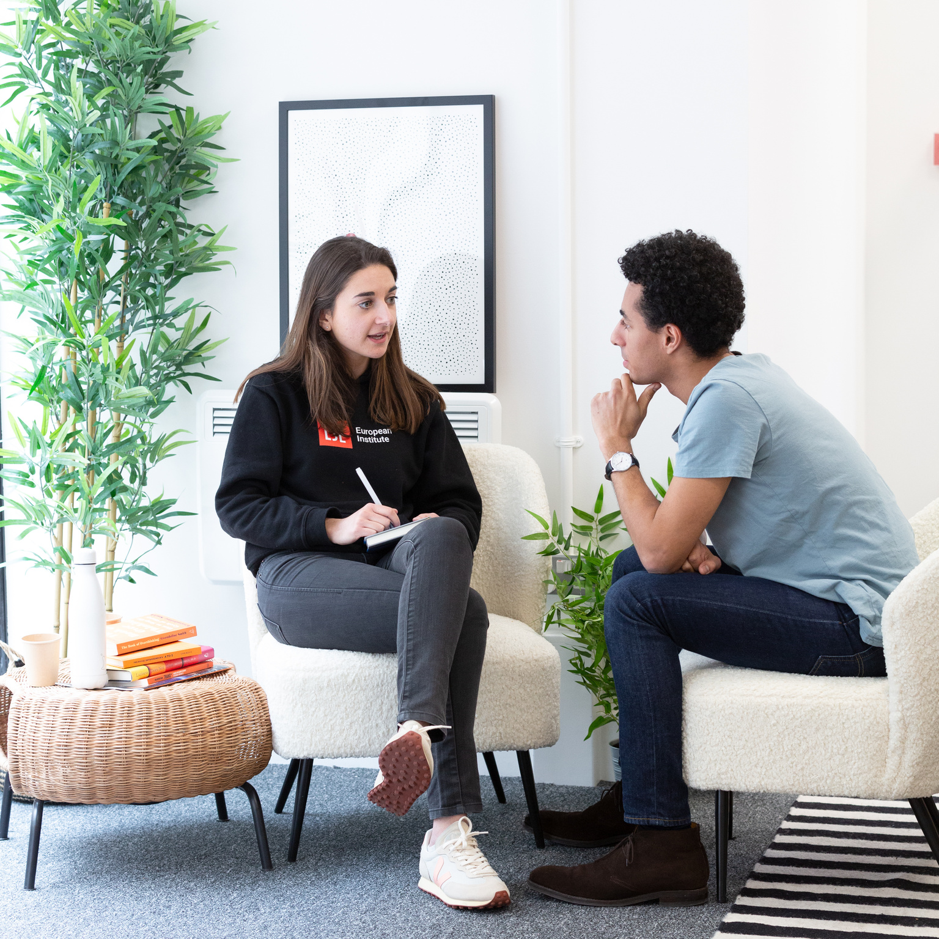
LSE Double Degree
Graduate Funding
2024/25 entry

Slide 2
Introductions:
Cat Todd
Deputy Head of FSO (UG & PGT)
Eric Sigmundsson
Financial Support Officer
Notes:
Some of the support would be applied for before you start

Slide 3
Cost of programme / Living in London
Tuition Fees
Varies depending on your chosen programme, please check fee webpages
Living Costs
LSE broadly estimates that students should allow £1,300 - £1,400 per month for all living expenses, including accommodation, travel, food, laundry, study costs, and other personal expenses. This will vary depending on your lifestyle and requirements, so it's important you do your own research.

Slide 4
Graduate Support Scheme 2024/25
Open to all - both Home UK and Overseas candidates
Needs based funding
Awards between £5,000 - £15,000 towards both fees and living costs
Can also be considered for other LSE Scholarships
Application form will be sent with guidance to your contact email address
Apply as early as possible; allow four weeks for a decision
Closing date for applications 30 June 2024
Notes:
You should receive an email around February/March which will include the application form and further information about applying.
You will need to submit the application and any supporting documents by email. Decisions will be sent by email, ideally within four weeks of receipt of your application.

Slide 5
Postgraduate Master’s Loan
For those that meet the eligibility criteria, a loan which can be used for fees or living costs is available from the UK government, administered by Student Finance (GOV.UK)
Non-means tested element; available to all who are eligible
The maintenance loan will be paid directly to your bank account you have registered with Student Finance. Apply at: https://www.gov.uk/masters-loan
Repayments start once you are earning over £21,000 a year
Notes:
Some departments will have an early deadline in December, please check the programme pages information carefully.

Slide 6
Financial Support - On-Course
Student Support Fund
Available to any registered student who experiences unexpected financial difficulties starting after registration
Awards up to £4,000 per academic session
Notes:
Can apply at any time during your programme

Slide 7
Click icon to add picture
Thank you for attending this session
How to get in touch:
Zoom drop-in sessions – speak to a member of the team for all general queries
Online enquiry form – use this form to submit any queries on funding from LSE
Email – financial-support@lse.ac.uk
Telephone – 020 7955 6609
Click icon to add picture

